Slide 1




EDUCATIONAL ACCESS SCHEMES
Steps to applying in 2020
Notes:
Animation: AUTOMATICALLY RUNS THROUGH 3 TIMES
AUDIO PLAYS UNTIL NEXT SLIDE

Slide 2

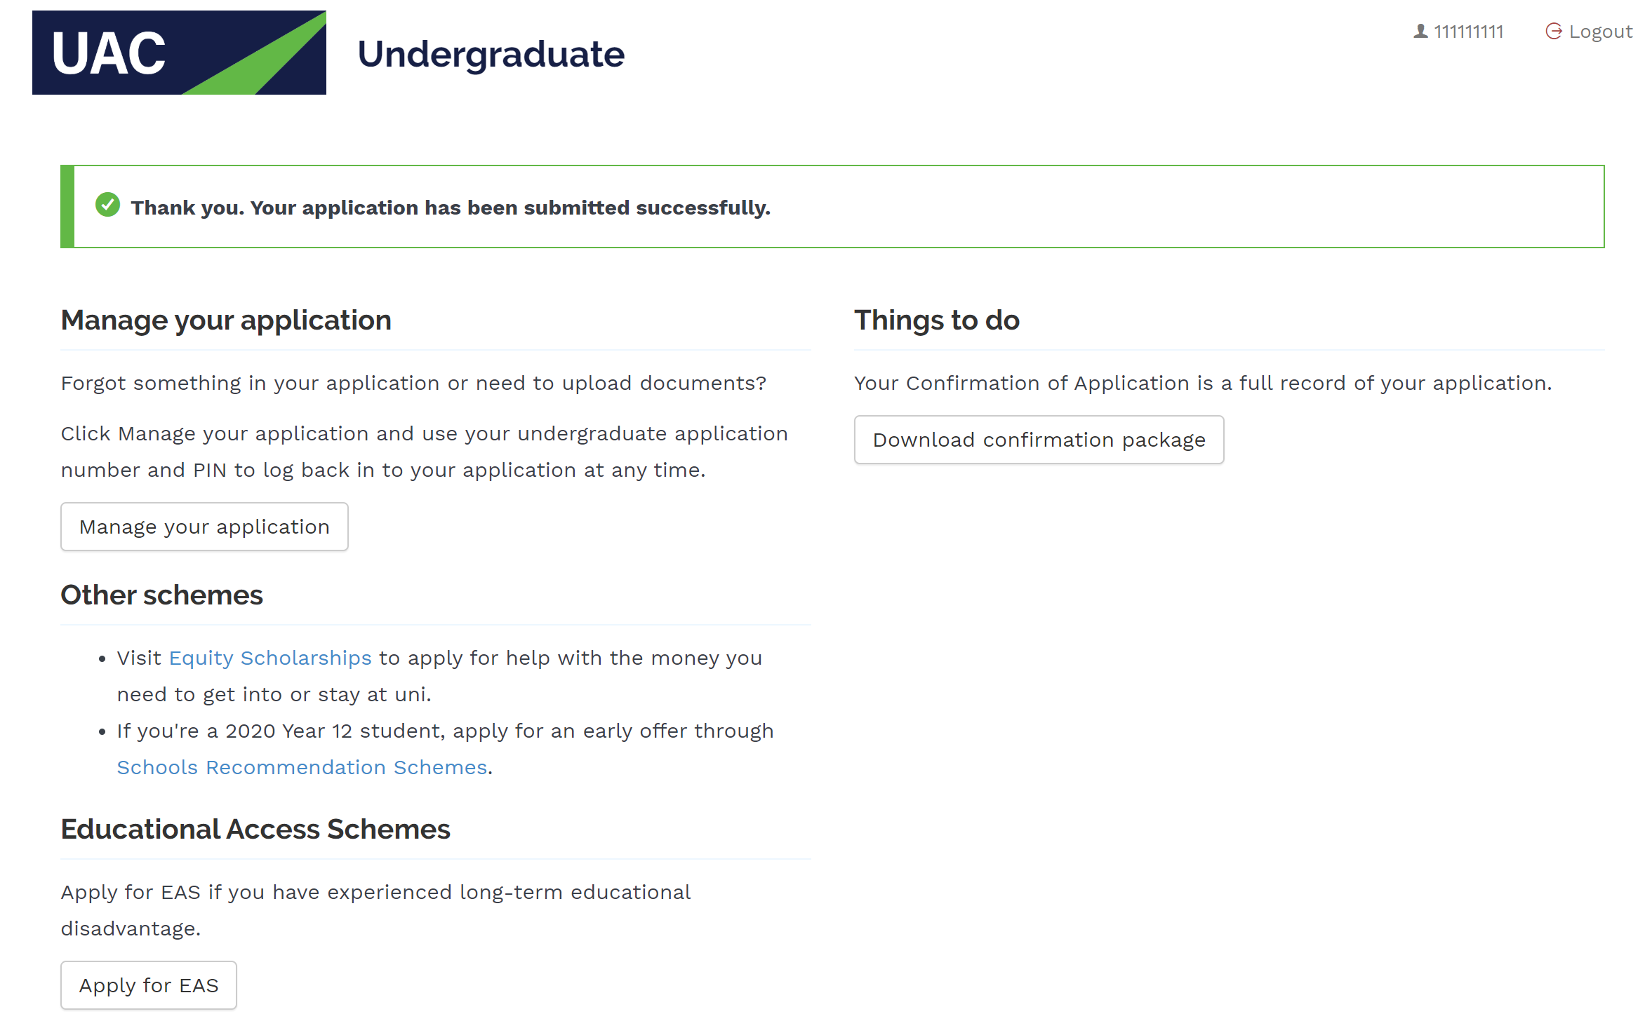
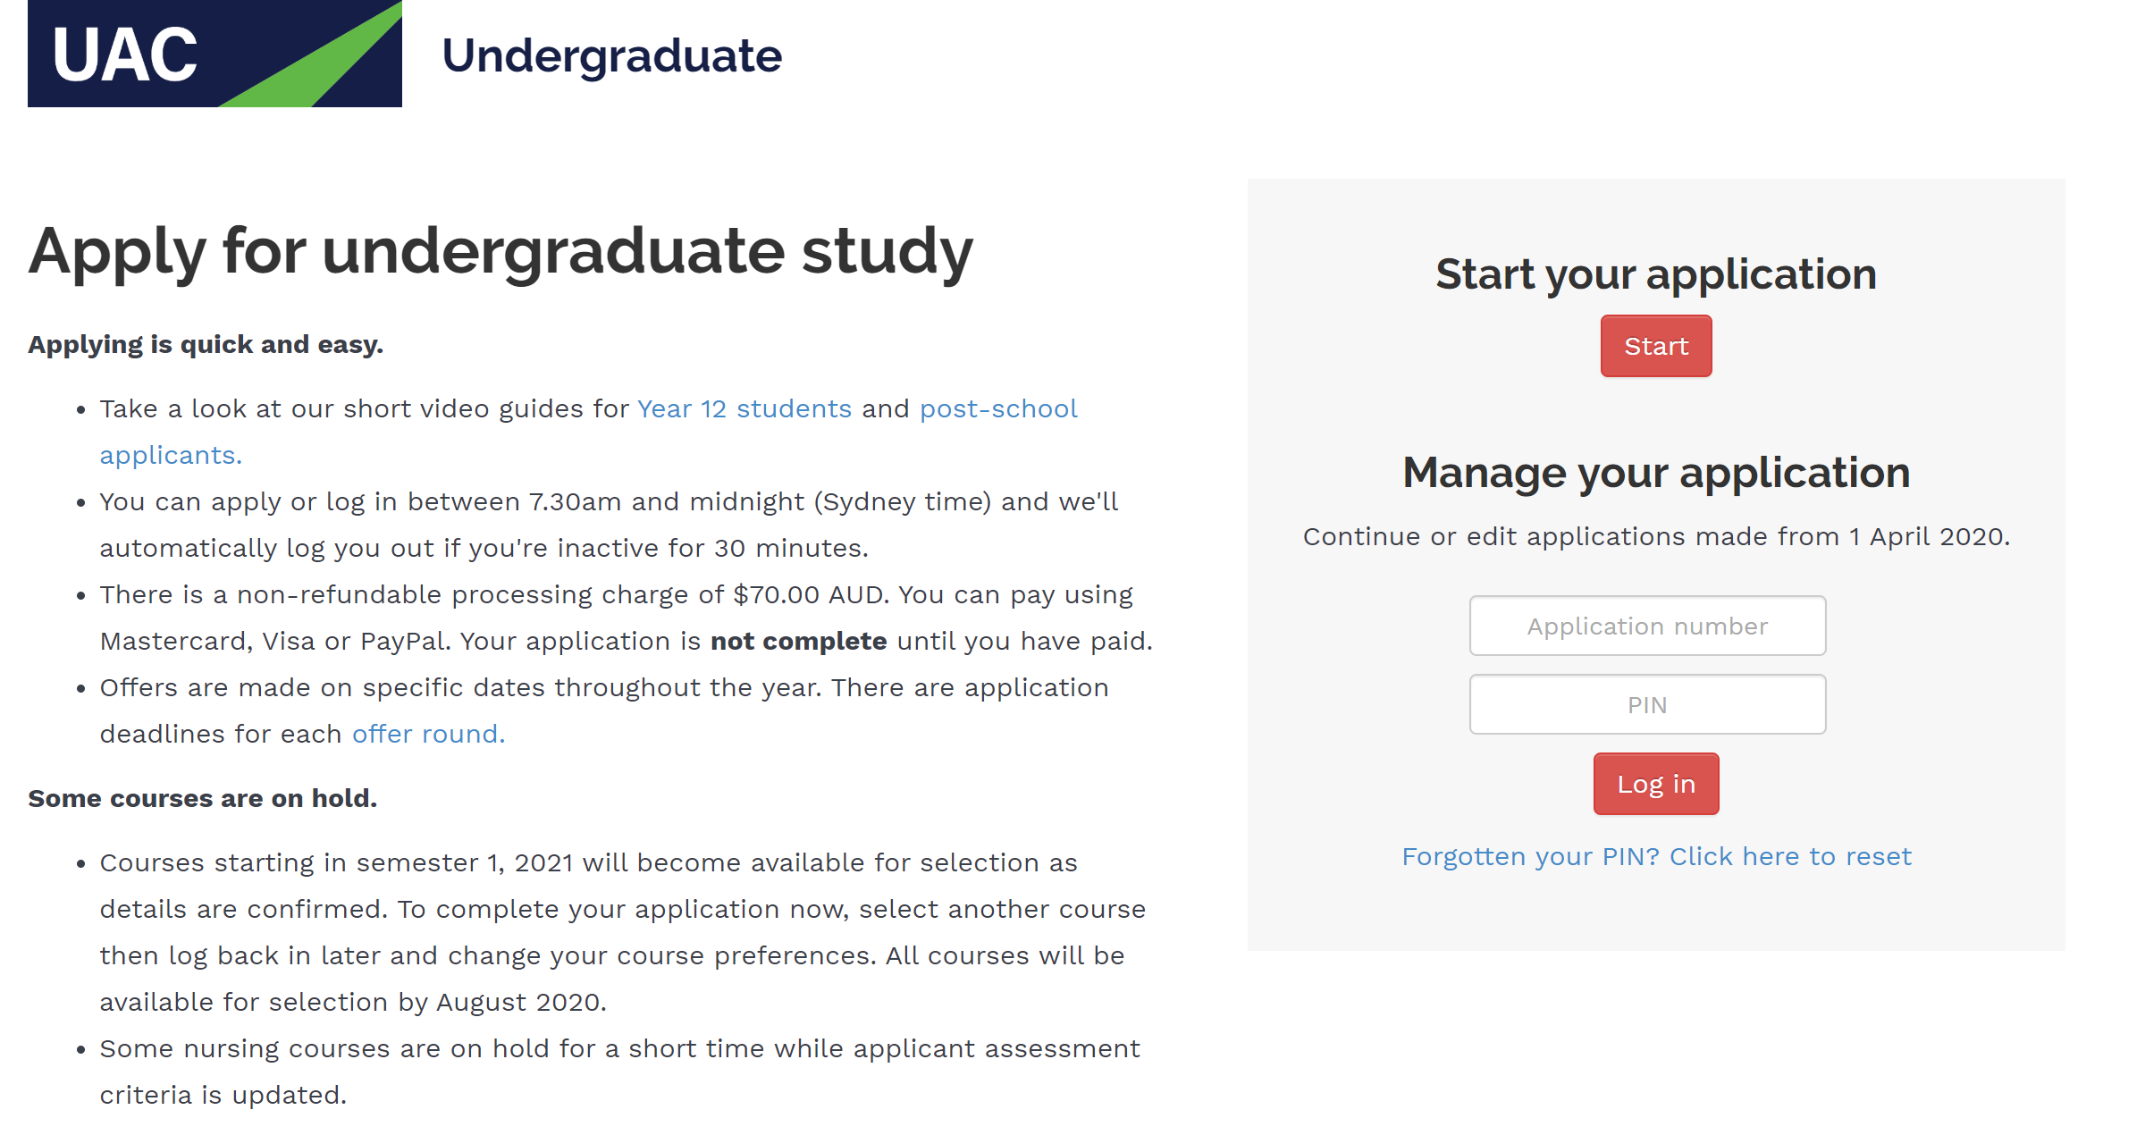
STEP 1: GET STARTED
Submit UAC undergraduate application.
Click ‘Apply for EAS’ on the application confirmation page or log back in to undergraduate application later using UAC application number and UAC PIN.

Slide 3
Note that at the end of the undergraduate application students can also link to the SRS and Equity Scholarships applications.
They can also access these additional applications from the ‘Apply or log in’ dropdown menu on the UAC homepage.

Slide 4
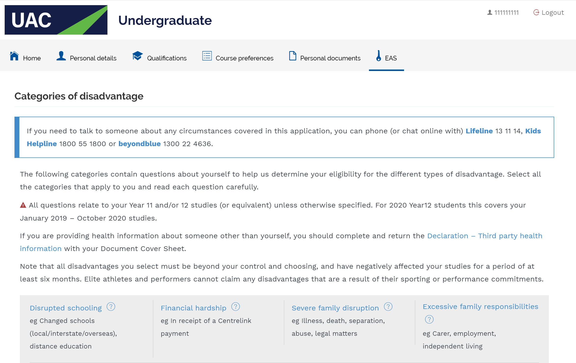
STEP 2: SELECT EAS TAB
When the EAS tab is selected, the categories of disadvantage will be displayed.

Slide 5
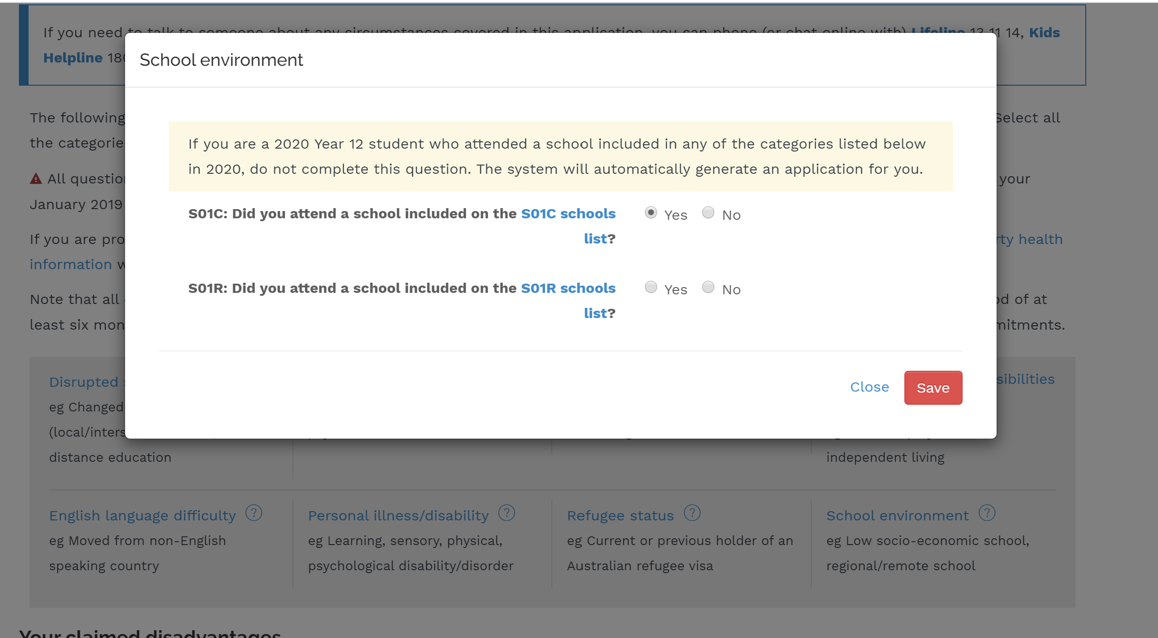
STEP 4: SELECT DISADVANTAGES
Click on each applicable disadvantage type.
Answer each question.
Save each section before moving on to the next disadvantage type.

Slide 6
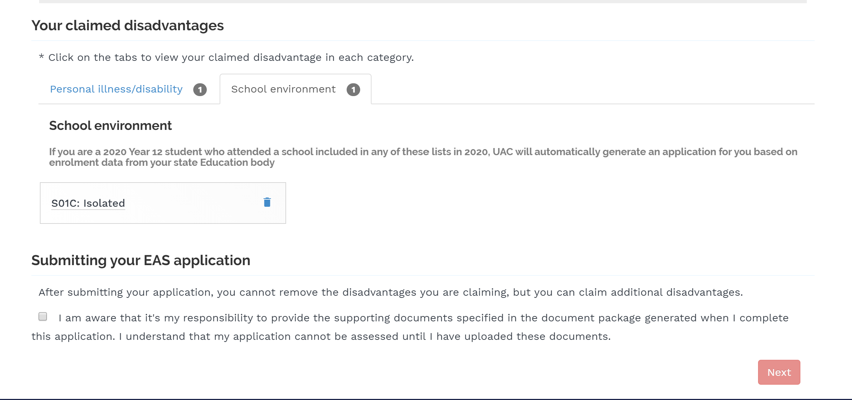
STEP 5: REVIEW CLAIMED DISADVANTAGES
Click on each disadvantage type that is being claimed to make sure all information is correct.

Slide 7
STEP 6: ACCEPT DOCUMENT REQUIREMENTS
Note that claimed disadvantages cannot be removed, but new disadvantages can be added at a later date.
Accept responsibility to upload supporting documents.

Slide 8
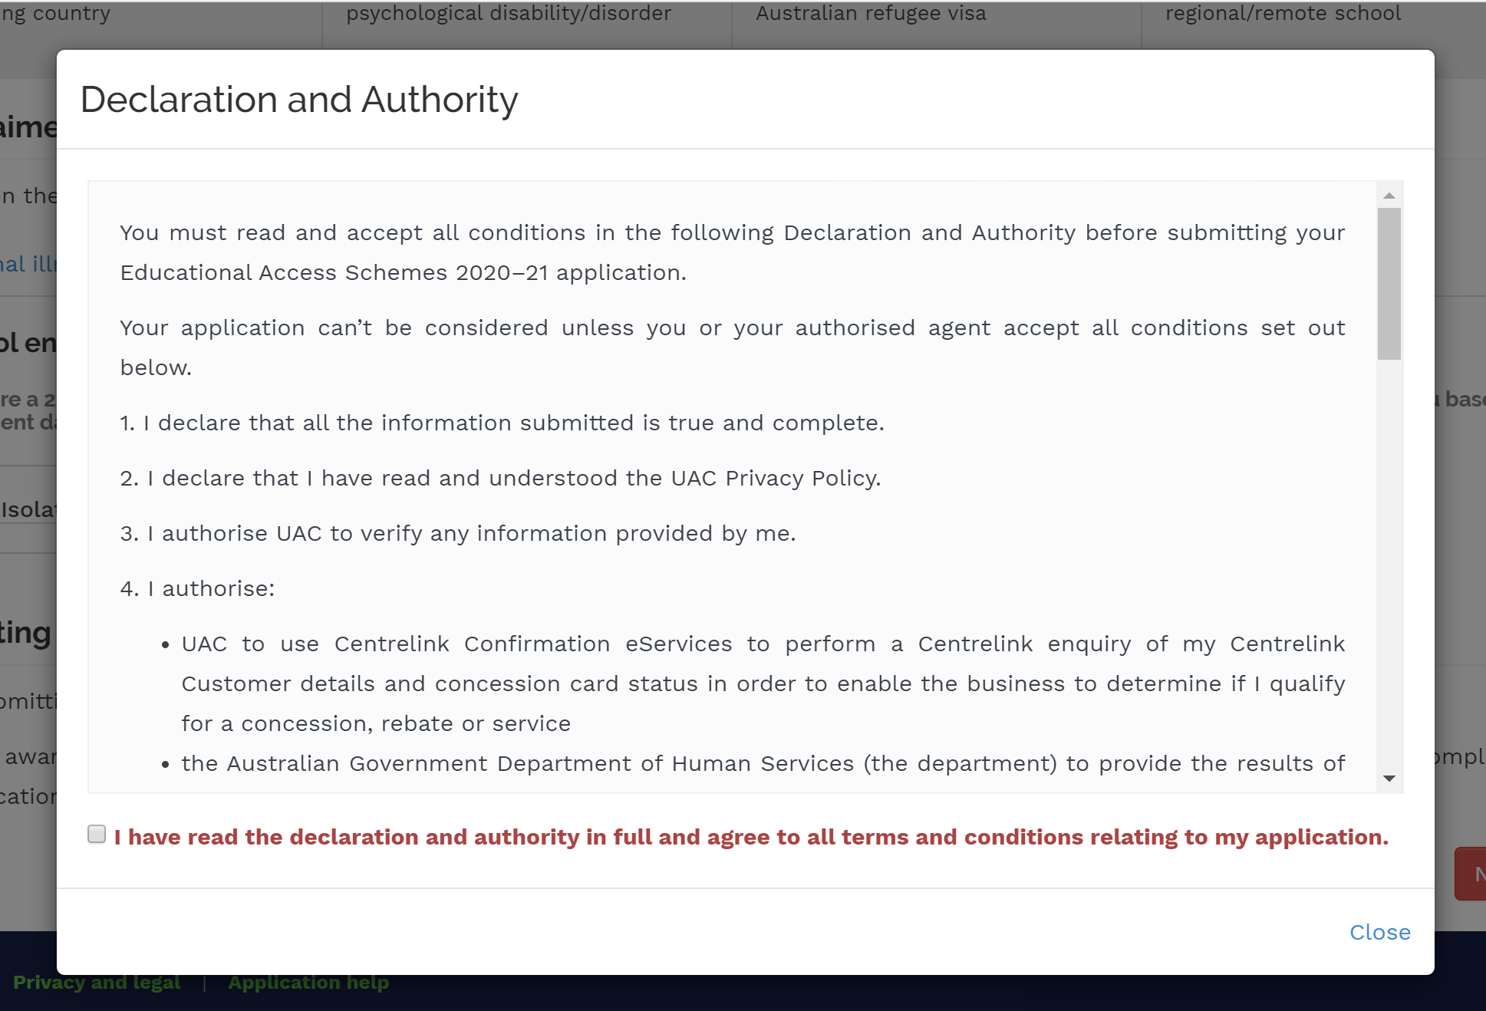
STEP 7: SUBMIT
Read the declaration and authority in full.
Accept the terms and conditions: that the information provided is true and complete and that UAC is authorised to gather information from Centrelink and any other government body.
Submit application.

Slide 9
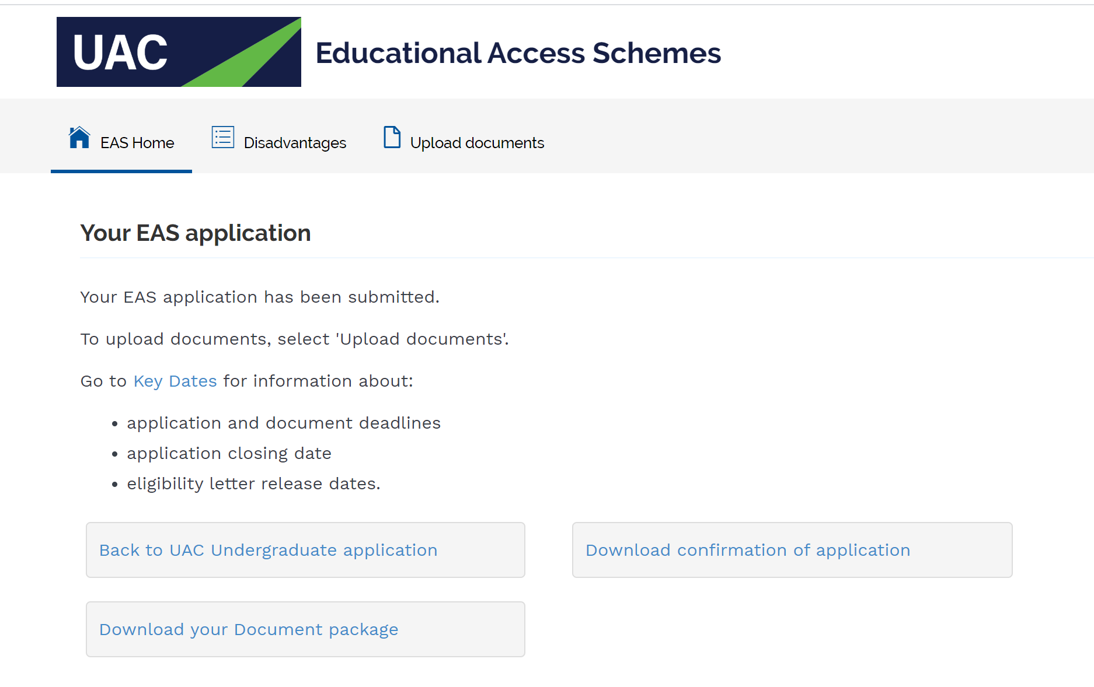
STEP 8: SAVE AND PRINT CONFIRMATION
Save and print confirmation of application + document package.
Obtain all required documents.
Select ‘Upload documents’ tab.

Slide 10
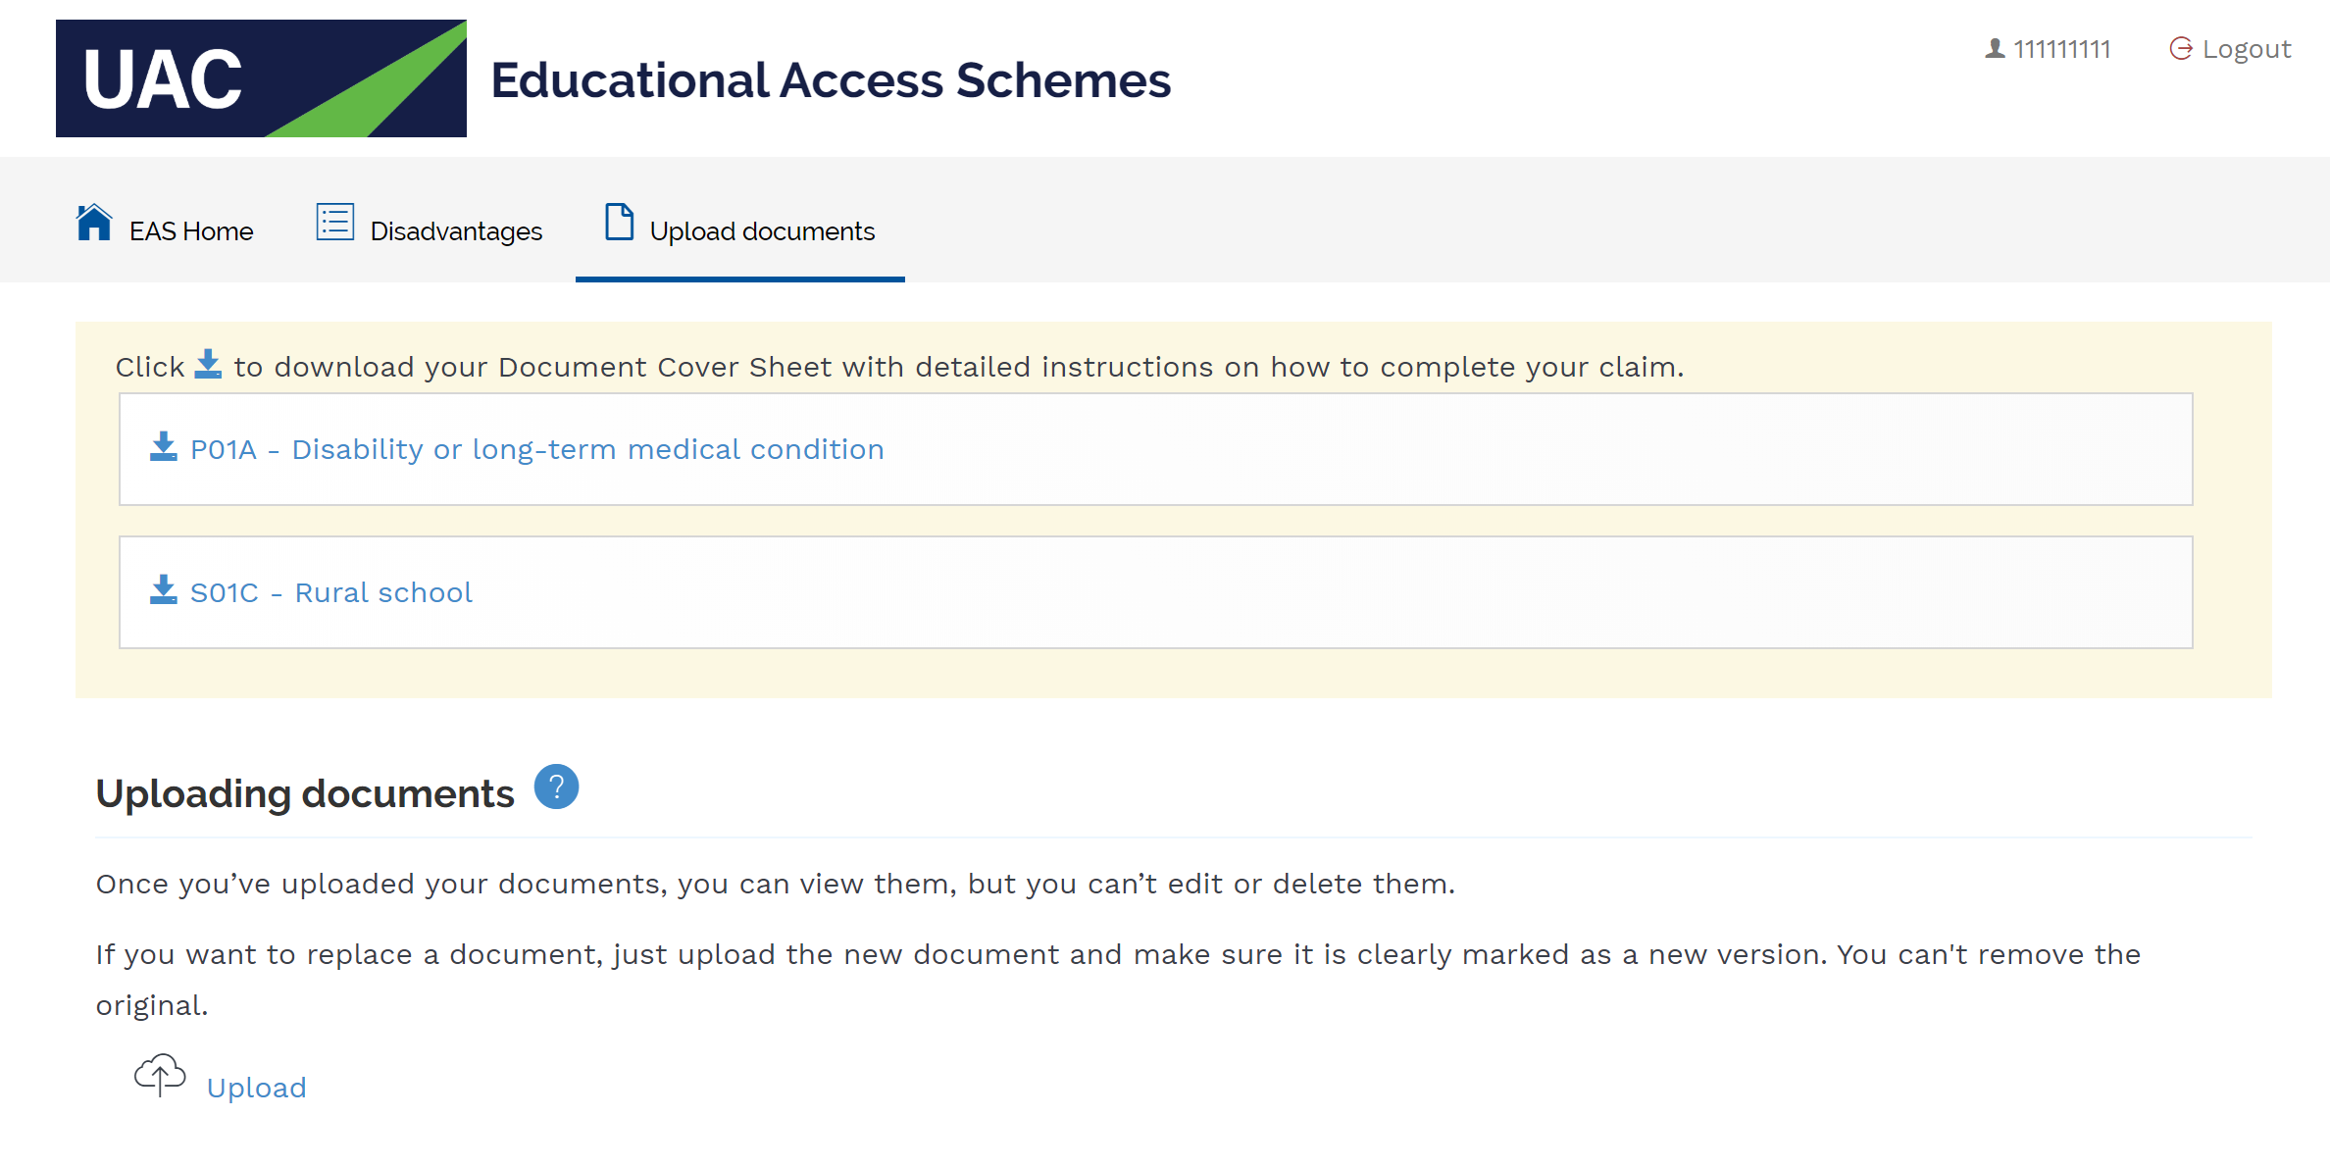
STEP 9: UPLOAD DOCUMENTS
Follow instructions to upload documents.
All documents must be in PDF format and less than 5MB in size.

Slide 11







CONNECT WITH US…
Email: ce@uac.edu.au

