Slide 1

“Where Young Men Achieve”
HSC 2017 / 2018
Information Evening
Tuesday 10/10/17

Slide 2


Slide 3
HSC DOCUMENTATION
At the completion of Year 12 you will receive
Individual course reports.
Higher School Certificate Record Of Achievement.
Higher School Certificate.
Students studying VET Courses also receive a Statement of Attainment.

Slide 4
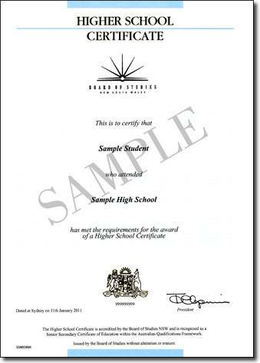
Reporting the HSC
Notes:
HSC Credentials include:
Testamur
Record of Achievement, with a statement of Preliminary Courses completed and the examination marks, moderated assessment marks and Level of Performance for HSC courses completed.
A Course Report for all courses in which a student sat an examination.

Slide 5
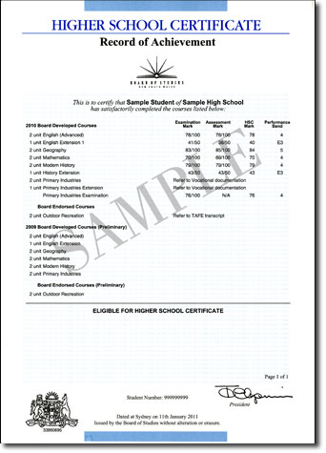
Reporting the HSC
Higher School Certificate Record of Achievement
Assessment mark - Schools submit an HSC assessment mark based on performance in school assessment tasks for every student in every course.
Examination mark - the examination mark for each course shows the student's performance in the Board's HSC examination for that course.
HSC mark - the HSC mark is a 50:50 combination of a student's external examination mark and school-based assessment mark for each course.
Performance band - a student's HSC mark for each course will fall within one of six performance bands, where the highest achievement is Band 6 (90–100) and where the minimum standard expected is 50.
Notes:
HSC Credentials include:
Testamur
Record of Achievement, with a statement of Preliminary Courses completed and the examination marks, moderated assessment marks and Level of Performance for HSC courses completed.
A Course Report for all courses in which a student sat an examination.

Slide 6
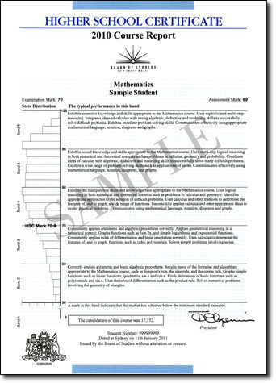
Reporting the HSC
Course Reports
Students receive an HSC course report for each course with an external examination that has been completed satisfactorily. The course report shows the student's assessment mark, examination mark, HSC mark and performance band with a description of what a student within that band typically knows, understands and can do.
Notes:
HSC Credentials include:
Testamur
Record of Achievement, with a statement of Preliminary Courses completed and the examination marks, moderated assessment marks and Level of Performance for HSC courses completed.
A Course Report for all courses in which a student sat an examination.

Slide 7
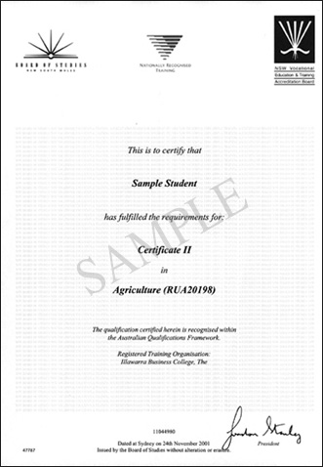
Reporting the HSC
AQF VET Certificate
This certificate is awarded to students in Vocational Education and Training (VET) courses who successfully complete all requirements of an Australian Qualifications Framework VET Certificate.
Notes:
HSC Credentials include:
Testamur
Record of Achievement, with a statement of Preliminary Courses completed and the examination marks, moderated assessment marks and Level of Performance for HSC courses completed.
A Course Report for all courses in which a student sat an examination.

Slide 8
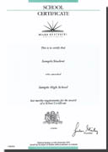
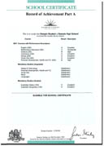
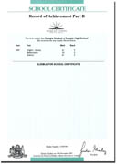
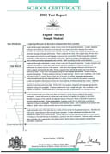
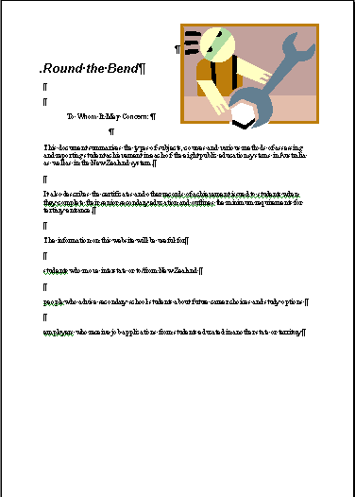
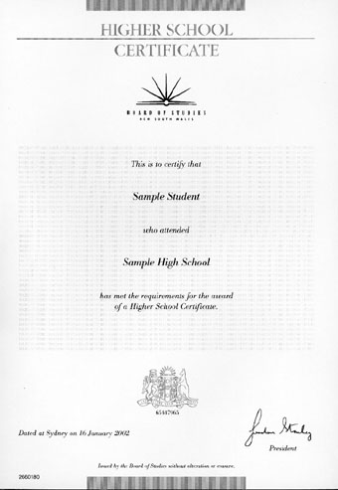
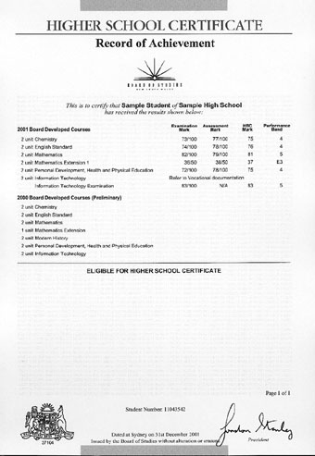
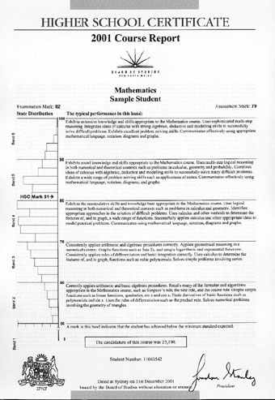
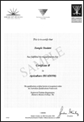
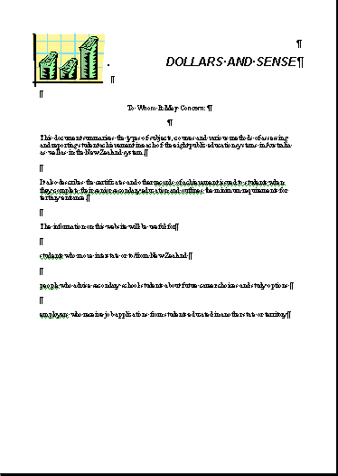
Using HSC Credentials in the Workplace
The Student Portfolio
  School Certificate and HSC reports, and workplace records and references
  Information for employers in assessing your suitability
Notes:
HSC Course Reports provide clear descriptions of what students know, understand and can do. The descriptions can be used by employers to help judge how well applicants may be suited to particular job requirements.
In addition, the course reports provide explicit state-wide standards which assist in making comparisons between prospective employees.
Students preparing applications for employment can draw from the band descriptions of their standard of achievement to address the particular skills and knowledge demands as well as to describe their overall abilities.

Slide 9
HSC Marks and Standards
  Marks reflect standards achieved
  Each student is assessed against known standards, as well as receiving their position in the course
  All students who reach the minimum standard will receive a mark of 50
  No predetermined number of students in each mark range.
  No limit on the number of students achieving top marks.
Notes:
9

Slide 10
EXTENSION COURSES
Have a maximum possible mark of 50
Are reported in relation to four performance bands: E1, E2, E3, E4
Have band cut off marks of:
Band 4 -45
Band 3 -35
Band 2 -25

Slide 11
SCHOOL BASED ASSESSMENT
Why use assessment tasks as part of the HSC Course?
  Using assessment tasks allows teachers to measure student achievement in all aspects of the course.
  Takes into account aspects which cannot be measured in a formal exam; eg practical or oral skills
  Takes away the pressure from just having one exam
Notes:
11

Slide 12
ASSESSMENT
When does HSC assessment begin?
  HSC Course assessment begins in term 4 of year 11 and ends towards the end of term 3 year 12.
  HSC Course assessment will only begin if Preliminary course work has been completed.
  The assessment policies and procedures booklet outlines the amount, type and timing of each task for each HSC course.
Notes:
12

Slide 13
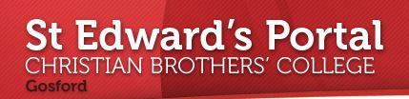
HSC ASSESSMENT TIMETABLE : TERM 4, 2017

Slide 14
ASSESSMENT
What are the rules regarding completion of tasks?
  Task must be submitted on time or a penalty of 20% per day late is applied.
  Absence from or failure to submit a task requires a medical certificate (for sickness) or other documentation (for reasons other than sickness)
  You must phone the college on the morning of the task to notify the teacher of your impending absence.
Notes:
14

Slide 15
ASSESSMENT
Rules (continued)
You must obtain and complete an illness and misadventure form on the day you return to school.
Students must complete assessment tasks that total more than 50% of total assessment otherwise they do not receive the HSC

Slide 16
ASSESSMENT
Rules (continued)
Tasks completed outside of class must be the students own work. Teachers will check that this is the case. (HSC All My Own Work)
Students completing assessment tasks on computer are encouraged to regularly print out their most recent work. Computer malfunction is not a grounds for misadventure
Special provisions are available for assessment tasks. Students need to inform the learning support team well in advance of their intention to use special provisions.

Slide 17
ASSESSMENT IN VET COURSES
In all VET courses students are assessed on their ability to perform a variety of different competencies.
The Board of Studies does not require an assessment mark from the school at the end of the HSC.
If a student wishes to use a VET course in the calculation of an ATAR (Australian Tertiary Admissions Rank) he must sit for the HSC exam.
The school is required to provide an estimated mark to the Board of studies and this is only used in the event of illness or misadventure on the day of the exam. The estimated mark provided to the Board of Studies is the students result in the Trial HSC Examination.

Slide 18
VET ASSESSMENT
Rules continued
VET students (Hospitality, Metals and Engineering, Sports Coaching, Construction and Entertainment) on work placement have the following responsibilities:
Find out from each of your teachers the work to be completed while you are on work placement.
If an assessment task is due while you are on work placement you must negotiate with your class teacher when you will hand in / complete the task.

Slide 19
Australian Tertiary Admission Rank (ATAR)
In 2009, the Universities Admissions Index (UAI) changed to the Australian Tertiary Admission Rank (ATAR).
The maximum ATAR is now 99.95 (as opposed to a maximum UAI of 100).
Achieving an ATAR of 99.95 is the same as achieving a UAI of 100.
Rules for the ATAR are the same as for the UAI.
There will be no changes to: scaling process, rank order of students, student selection for university courses

Slide 20
Australian Tertiary Admission Rank (ATAR)
Other criteria such as a portfolio, interview, audition, questionnaire or test may also be taken into account in conjunction with the ATAR for certain courses.
Calculation of the ATAR is the responsibility of the University Admissions Centre (UAC) not the Board of Studies

Slide 21
ATAR Calculation
The best 10 units of marks from Board Developed courses are used to calculate this mark.
Included in this mark are:
- 2 units of English
- At most 2 units of Category B subjects (Construction, Hospitality, Entertainment, Metals and Engineering, and TVET Courses)
English Studies, although a board developed course, does not contribute in the calculation of the ATAR.
Board Endorsed Courses are not used in calculating the ATAR (Photography, Sports Coaching, Catholic Studies and Mathematics General 1.)

Slide 22
Calculating the ATAR
Raw Moderated
Exam + Assessment Marks
Board of Studies
Universities Admissions Centre
The scaled mark
for each course is
based on the quality
of the candidates in that course in that year
Scaled
2 units of English + next best 8 units
ATAR

Slide 23
HSC marks and the ATAR rank
The middle ranked students in the cohort receive an ATAR of around 66.00
Recent trends have indicated that middle-placed HSC students received HSC marks in the 70s, whereas middle-ranking ATAR’s have remained in the 60s.
Notes:
Note: UAC scaling is not predetermined. It is based on the quality of the candidates that sat for each course in each year
In previous years there was some correspondence between middle-placed HSC marks and the middle-ranking UAIs
Students who received middle-placed HSC marks in the 60s also generally received middle-ranking UAIs in the 60s.
In 2001, middle-placed HSC students received HSC marks in the 70s, whereas middle-ranking UAIs remained in the 60s.

Slide 24
The HSC and the ATAR in summary
HSC is for all students
  the HSC presents a profile of student achievement across a broad range of subjects
ATAR is for students wishing to gain a place at a university
(approximately 30% achieve a place in their first year after leaving
school)
  the ATAR is an index used to rank school leavers for tertiary places.
  It does not summarise 13 years of schooling
Pathways
  The ATAR is limited to one of the many pathways open to school leavers with the HSC

Slide 25
“Where Young Men Achieve”
HSC 2017 / 2018
Information Evening
Tuesday 10/10/17

Slide 26
ATAR ESTIMATOR
Username: 13fred
Password: College17

Slide 27
ATAR RULES
The best 10 units of marks from Board Developed courses are used to calculate this mark.
Included in this mark are:
- 2 units of English
- At most 2 units of Category B subjects
(Construction, Hospitality, Entertainment, Metals & Engineering, TVET Courses)
Board Endorsed Courses are not used in calculating the ATAR.
(Photography, Sports Coaching, Religion-school course)

Slide 28
Sample ATAR Cut-offs- University Courses 2016
Australian Catholic University
B Ed (Primary) 60.00
B Teach/ B Arts (Sec Maths) 60.00
B Theology/ B Philosophy 58.50
B Arts 58.50
B Commerce 58.50
B Exercise and Sport Science 59.00
B Laws 81.65
Charles Sturt University (Albury, Bathurst,
Dubbo, Orange, Wagga Wagga)
B Business (Marketing) 65.00
B Education (Primary) 70.00
B Exercise and Sports Science 70.00
B Physiotherapy 85.10
B Applied Science (Parks& Rec) 70.00
B Business Studies 65.00
B Arts 65.00
B Business (Management) 65.00
B Animal Science 70.00
Available from the University Admissions Centre Website

Slide 29
Planning for success
The sort of tertiary courses I would like to consider have a ATAR between ………. and ………..
To achieve the ‘goal ATAR’ I think I might need to …………
The two courses I am most confident about are ………..
The course I am having most difficulty with is............
The course I could probably improve in most easily is …………
The best way for me to concentrate on getting the marks in Assessment tasks and the HSC exams I want this year would be to ……

Slide 30
Planning for success
Teachers are keen to help
Ask for feedback – what do I have to do to improve?
Start Assessment tasks early and seek feedback.
Work conscientiously and consistently in class.
Do the revision that teachers set.
Work out a way of doing your own revision. Ask your teachers how to go about this revision.
Look for help to plan how to go about Assessment tasks and exam preparation.

